Slide 1



Quantum ESPRESSO on HPC and GPU systems: parallelisation and hybrid architecture
Carlo Cavazzoni – c.cavazzoni@cineca.it
Cineca & MaX

Slide 2

The persistence need for more powerful computational resources
Scientific Progress Without Computers
(two paradigms)
Scientific Progress With Computers
(four paradigms)
Experiments
data
Theory?
Experiments
data
Theory?
Implicit Models (AI)
Time depend on computational resources
Hundreds
of years
knowledge
Hundreds
of years
knowledge
Virtual Exp. Simulations
Experiments?
models
Theory
Experiments?
models
Theory
HPC & Data Processing are a knowledge accelerator: the more the better!
The progress of modern scientific research itself leads to an ever-increasing need for computational capacity as an inevitable consequence.

Slide 3
The end of chip downsizing
The end of chip downsizing

Slide 4
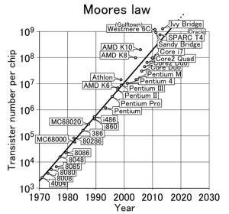
Moore’s law
Moores Law

Slide 5
Performance Development
1 Eflop/s
100 Pflop/s
N=1
10 Pflop/s
N=10
1 Pflop/s
100 Tflop/s
SUM
N=100
10 Tflop/s
1 Tflop/s
100 Gflop/s
10 Gflop/s
1 Gflop/s
Tflops (10¹²)
Achieved
ASCI Red
Sandia NL
Pflops (10¹⁵)
Achieved
RoadRunner
Los Alamos NL
Eflops (10¹⁸)
Achieved?
China says 2020
U.S. says 2021
Source: J.Dongarra
Notes:
US 26
Japan 13
China 8 – Nov 2010 and last 7 lists

Slide 6
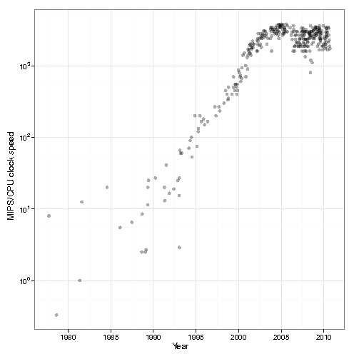
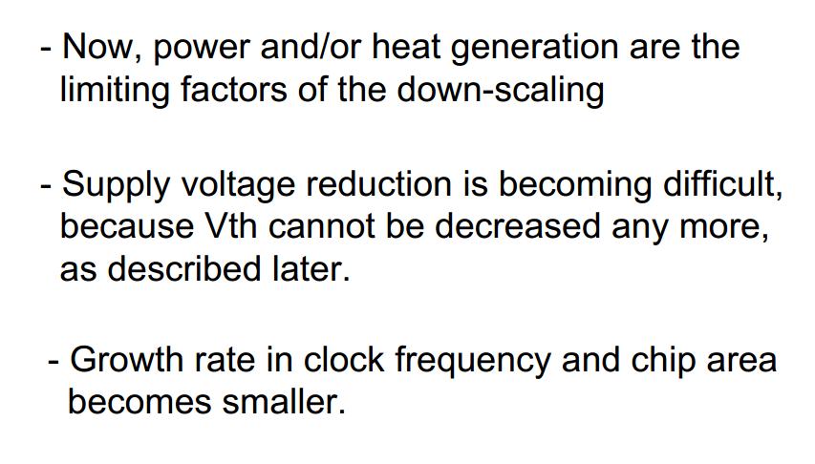
Dennard scaling law (downscaling)
new VLSI gen.
old VLSI gen.
L’ = L / 2
V’ = V / 2
F’ = F * 2
D’ = 1 / L² = 4D
P’ = P
do not hold anymore!
The core frequency
and performance do not
grow following the
Moore’s law any longer
L’ = L / 2
V’ = ~V
F’ = ~F * 2
D’ = 1 / L² = 4 * D
P’ = 4 * P
Increase the number of cores
to maintain the
architectures evolution
on the Moore’s law
The power crisis!
Programming crisis!

Slide 7
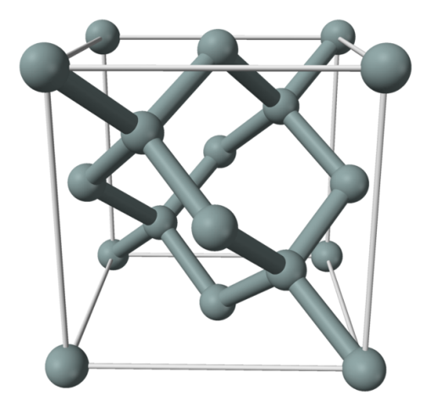
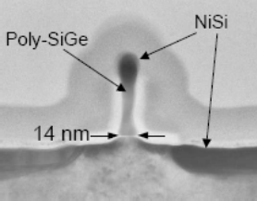
The silicon lattice
0.54 nm
Si lattice
50 atoms!

Slide 8
Amdahl's law
In a massively parallel context, an upper limit for the scalability of parallel applications is determined by the fraction of the overall execution time spent in non-scalable operations (Amdahl's law).
maximum speedup tends to
1 / ( 1 − P )
P= parallel fraction
1000000 core
P = 0.999999
serial fraction= 0.000001

Slide 9
HPC Trends
Peak Performance
Exaflops
10^18
Moore law
FPU Performance
Gigaflops
10^9
Dennard law
Number of FPUs
10^9
Moore + Dennard
serial fraction
1/10^9
App. Parallelism
Amdahl's law

Slide 10
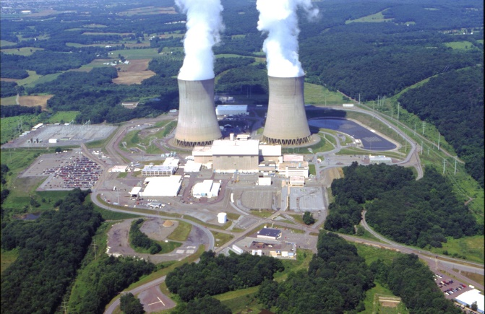
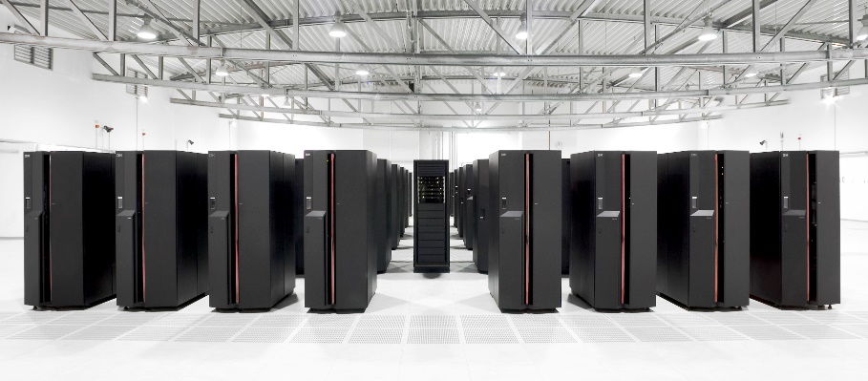
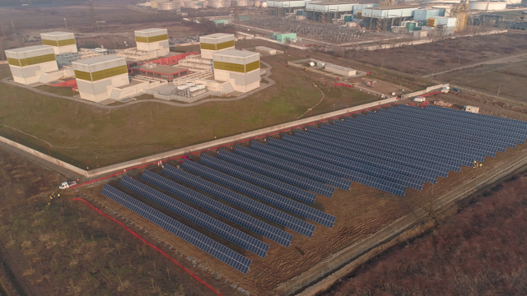
Supercomputers vs Energy

Slide 11

Energy trends
“traditional” RISK and CISC chips are designed for maximum performance for all possible workloads
A lot of silicon to maximize single thread performace
Energy
Datacenter Capacity
Compute Power

Slide 12
Energy trends & floating point
Chip Area
Numerical precision

Slide 13
Relative energy and area costs of different datatypes
Operation | Energy (pJ) | Area (μm²)
int8 addition | 0.03 | 36
int16 addition | 0.05 | 67
int32 addition | 0.1 | 137
float16 addition | 0.4 | 1,360
float32 addition | 0.9 | 4,184
int8 multiplication | 0.2 | 282
int32 multiplication | 3.1 | 3,495
float16 multiplication | 1.1 | 1,640
float32 multiplication | 3.7 | 7,700
2x
2.25x
3.08x
2x
3.36x
4.70x
Sources:
https://ai.intel.com/flexpoint-numerical-innovation-underlying-intel-nervana-neural-network-processor/, https://media.nips.cc/Conferences/2015/tutorialslides/Dally-NIPS-Tutorial-2015.pdf, http://ieeexplore.ieee.org/document/6757323/.
Source: Jeff R. Hammond (Intel)

Slide 14


Change of paradigm
New chips designed for maximum performance in a small set of workloads
Simple functional units, poor single thread performance, but maximum throughput
Energy
Datacenter Capacity
Compute Power

Slide 15
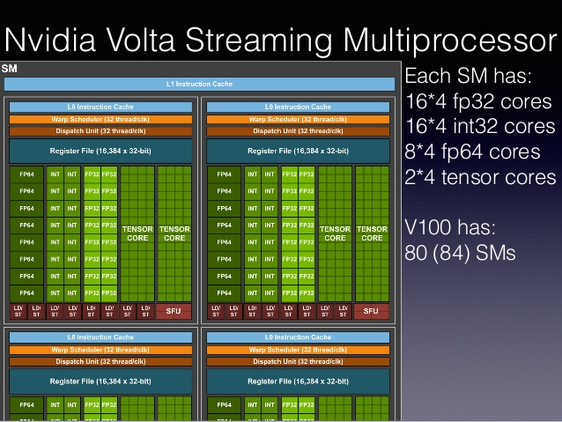
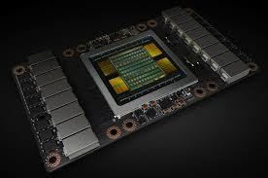

Specialized cores

Slide 16
Exascale How serious the situation is?
Peak Performance
10^18 Flops
Moore law
10^5 FPUs in 10^4 servers
Number
of FPUs
FPU Performance
10^9
10^4 FPUs in 10^5 servers
10^9 Flops
Dennard law
Working hypothesis
Exascale Architectures
Heterogeneus

Slide 17




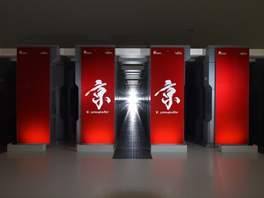
Exascale Race
China (2021-2022)
Xiaomi, ShenWei, Hygon
Frontier (Cray-AMD w GPU)
U.S. (2021-2023)
EuroHPC (2023)
ARM by EST+GPU
Japan (2022)
Aurora 21 (Cray-Intel w GPU)
Build a supercomputer capable
of 10^18 Double Precision Floating Point Operation per Second
Fugaku (Fujitsu w ARM)

Slide 18
EuroHPC Activities
2017 signature of Rome memorandum
2018 Joint Undertaking for EuroHPC established
total budget > 1B€
2019 Infrastructure and Research and Innovation calls
European Processor Initiative
2020 First petascale and pre-exascale systems installed
Italy will host Leonardo
2023 First European exascale system installed
based on European technology
Infrastructure
Research and Innovation
HPC Ecosystem
The Infrastructure Pillar
  Procurement of 3 pre-exascale machines and 5 petascale machines
The Research and Innovation Pillar
    R&I, exascale technologies and systems (incl. low-power processor); applications; skills
Notes:
Pillar 1 + 4: Infrastructure + Operating the machines (680 m€)
2 pre-exascale (2x125 m€ CAPEX + 2x125 m€ OPEX) – 500 m€
3 mid-range (3x30 m€ CAPEX + 3x30 m€ OPEX) – 180 m€
Pillar 2 + 3: Applications & Skills + R&I (381 m€)
extreme scale technologies for key applications + building blocks + co-designed integration/demonstrators + widening access of HPC
Operations (30 m€)
covering running costs from 2019 to 2026

Slide 19
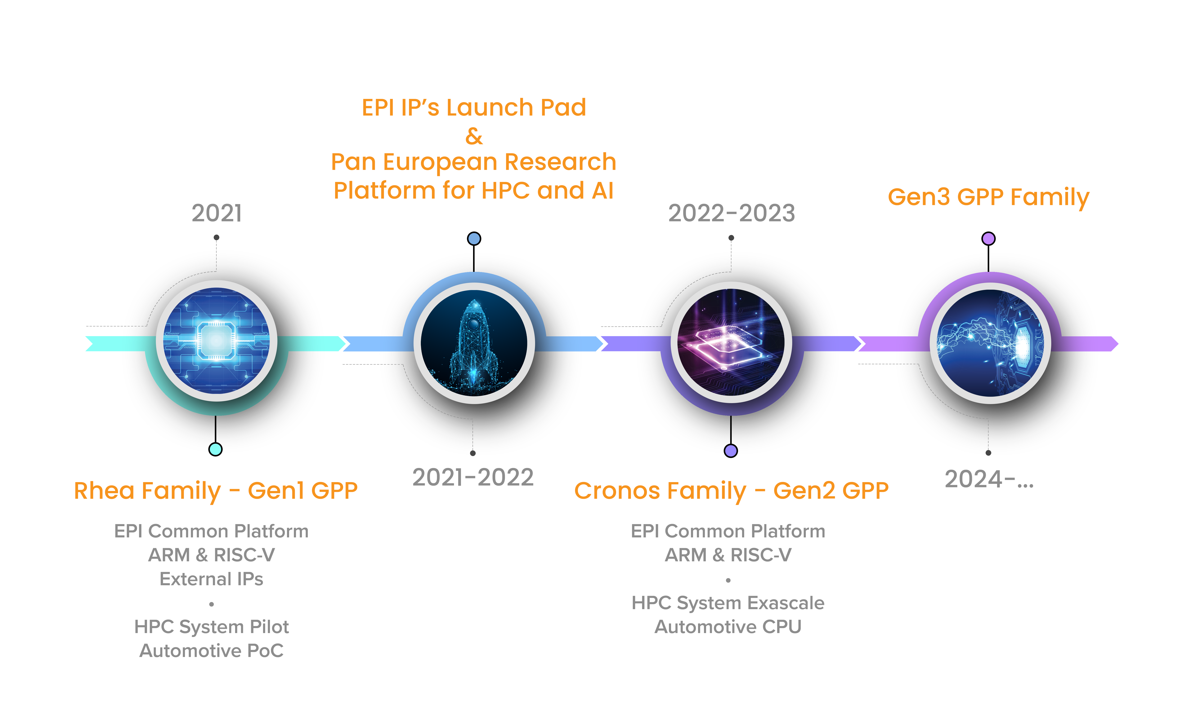
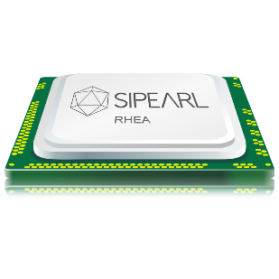
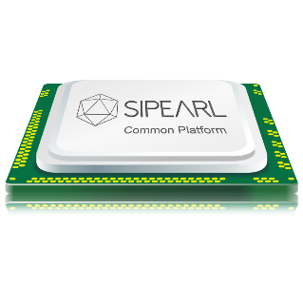
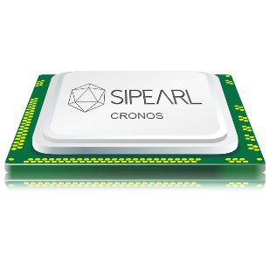
ROADMAP

Slide 20





Leonardo EuroHPC pre-exascale
Partnership
SISSA - ISAS
+
Consortium (Slovenia, Hungary, Slovakia, Austria)

Slide 21
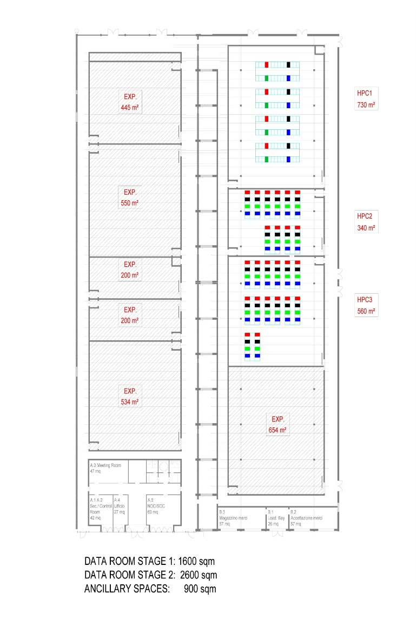
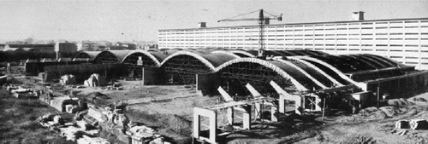
Leonardo Supercomputer @ Bologna Science Park
250-300PFlops (10^15 Flops/sec)
Top 3 system in the world
Computer Rooms
10MW (2020)
20MW (2023)
ECMWF
PUE < 1.1

Slide 22
Leonardo concept
Pre-exascale
8MW hot-water DLC +
2MW Air cooled
~ 1000 m^2
Booster
3500 nodes
4GPUxnode
General Purpose
1000 nodes
High core count
Data Centric
500 nodes
Large mem
System name | Leonardo
Modules | 3 (booster, general purpose, data centric)
Number of computing nodes | 5000 (3500+500+1000)
Storage | Capacity: 150 PB, bandwidth: 1 TB/s
HPL Targeted Performance (peak) | 150-180 PFlops (210-250 PFlops); Top 3
HPCG Targeted Performance | 2.8-3.3 PFlops; Top 3
I/O | ≥ 150 PB
Interconnection Bandwidth | ≥ 200 Gb/s
Estimated Power consumption (after PUE) | 8-9 MW (8.8-9.9 MW)

Slide 23
What about applications
The experience of MaX

Slide 24
General Consideration
Exascale is not (only) about scalability and Flops performance!
  In an exascale machine there will be 10^9 FPUs, bring data in and out will be the main challenge.
  10^4 nodes, but 10^5 FPUs inside the nodes!
There is no silver bullet (so far)
  heterogeneity is here to stay
  deeper memory hierarchies
Carlo Cavazzoni

Slide 25
concerns
From GPU to specialized core (tensor core)
Specialized memory module HBM
Specialized non volatile memory NVRAM
Refactor code to better fit architectures with specialized HW
Avoiding WRONG TURN!

Slide 26
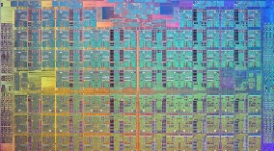
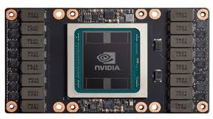
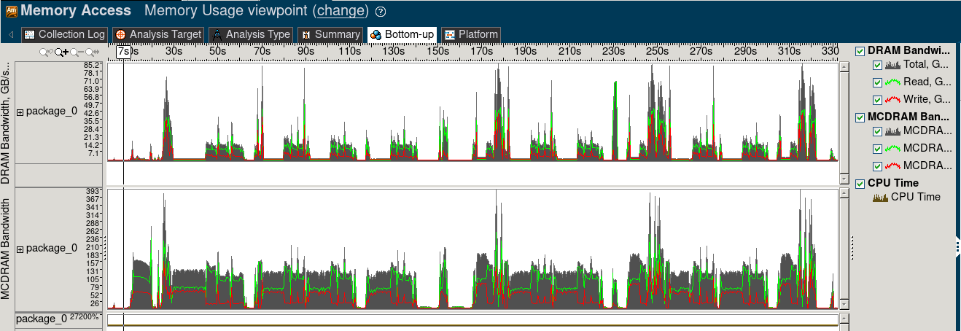
Paradigm and co-design
Identify latency and throughput
sub/module/class
Map to HW
App workflow
latency
Re-factor
throughput
Latency code
knl
Throughput code
host
comm
Map and
Overlap
latency
throughput
Heterogeneus

Slide 27
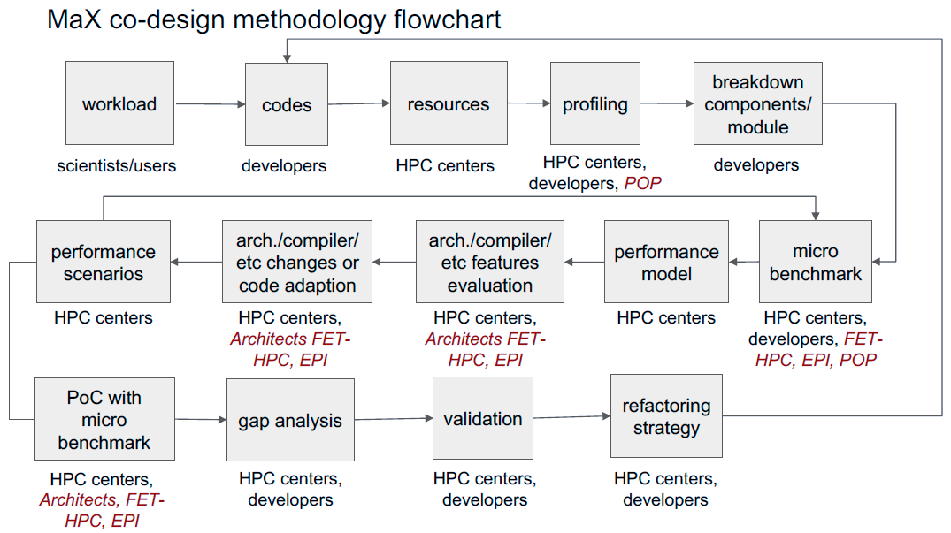
Co-design cycle

Slide 28
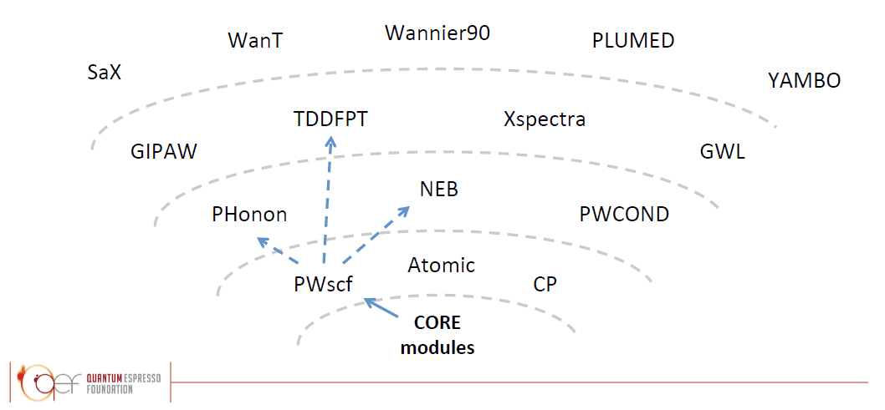
Separation of concerns
Beyond Modularization
QE - Libraries
FFTXlib
LAXlib
Other codes
Mini-app

Slide 29
mixed-precision
Iterative solvers that converge smoothly.
  For coupled-cluster methods (CC), iterate with float32 until converged, promote to float64 and then iterate to desired convergence. This achieves ~90% of float32 performance with same accuracy as using float64 from the outset.
  This is easy with C++ templates but can be done in any language by compiling twice.
Methods where sorting input data leads to stable summation.
  See papers by Todd Martinez and coworkers on DFT and TDDFT on GPUs for details.
Truncation error in methods corresponding to smooth integrals tend to be small.
  Perturbative triples portion of CCSD(T) sums a huge number of small terms to a scalar. As long as the summation is done into float64, the intermediates can be computed with float32 at a tolerable loss of accuracy. (implemented in NWChem)
Source: Jeff R. Hammond (Intel)

Slide 30
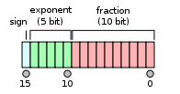
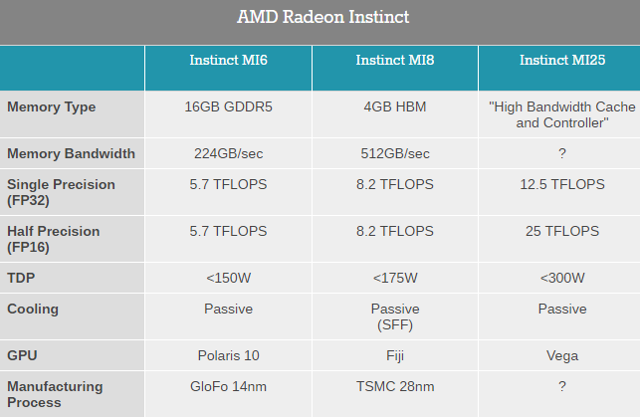
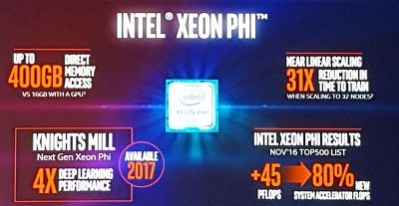

IEEE 754 Half Precision (16-bit) Floating Pt Standard
A lot of interest driven by “machine learning”
FP16
FP16
Source: J.Dongarra

Slide 31
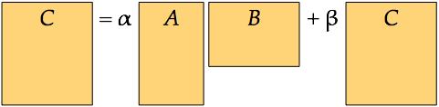
Leveraging Half Precision in HPC on V100
Study of the Matrix Matrix multiplication kernel on Nvidia V100
dgemm achieve about 6.4 Tflop/s
sgemm achieve about 14 Tflop/s
hgemm achieve about 27 Tflop/s
Tensor cores gemm reach about 85 Tflop/s
~12X
Matrix matrix multiplication GEMM
Source: J.Dongarra

Slide 32
Optimize QE
Profiling
Programming Paradigms
Libraries
Co-design
Hot spots
Performance issues
bottlenecks
Flops and watts
efficiency
New MPI and OpenMP Standards
New Para.
OmpSS
DSL
Kernel Libraries
module
Perf. Models
New arch.
New more efficient code version
Library/module shared
Codes/community/vendor
Feedback to communities
Dissemination of best practice
Schools and Workshops
Collaborations
With other projects
CoE/FET/PRACE

Slide 33
Typical supercomputer FAT TREE setup
(Marconi OmniPath Network)
Core Switches
(Few units)
Hedge Switches
(Few hundreds)
Compute nodes
(Thousands)

Slide 34
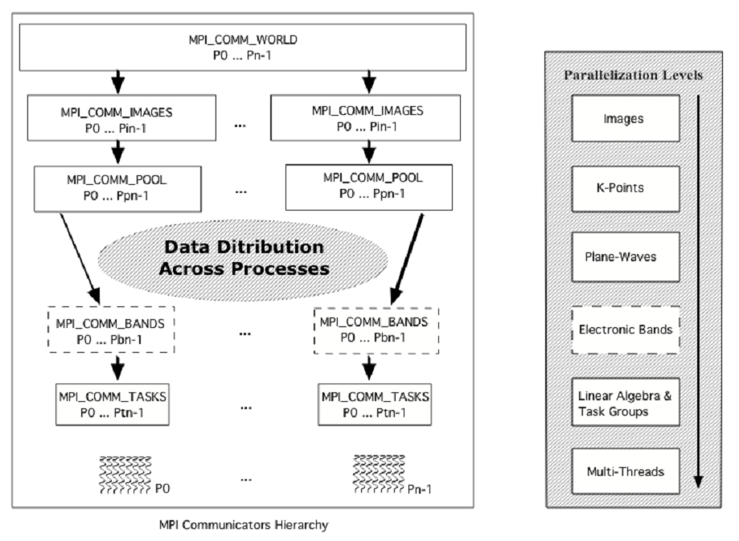
Parallel structure of Quantum Espresso

Slide 35
Coarse Grain, high level data distribution

Slide 36
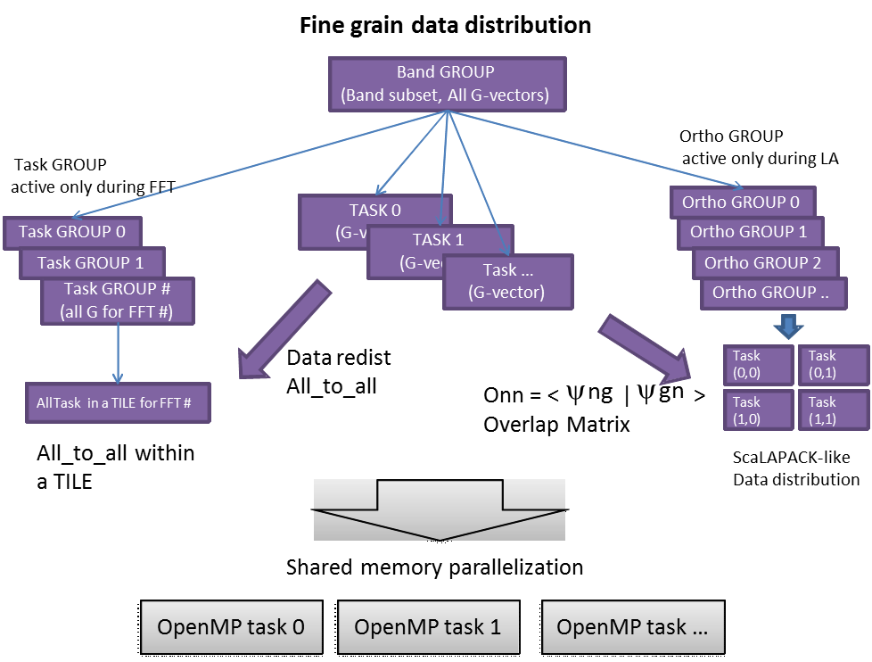
Fine Grain
data distribution
Challenge: tuning parallelization parameters

Slide 37
CP.X with SP h_psi
out_201807181631.dp: fft : 44.27s CPU 23.12s WALL ( 8008 calls)
out_201807181631.dp: ffts : 11.31s CPU 5.87s WALL ( 2002 calls)
out_201807181631.dp: fftw : 388.64s CPU 203.80s WALL ( 96096 calls)
out_201807181631.dp: fft_scatt_xy : 71.20s CPU 37.20s WALL ( 106106 calls)
out_201807181631.dp: fft_scatt_yz : 145.65s CPU 76.34s WALL ( 106106 calls)
out_201807181631.dp: fft_scatt_tg : 26.02s CPU 14.51s WALL ( 96096 calls)
---------------------------------
out_201807181631.sp: fft : 44.01s CPU 22.91s WALL ( 8008 calls)
out_201807181631.sp: ffts : 11.23s CPU 5.83s WALL ( 2002 calls)
out_201807181631.sp: fftw : 320.71s CPU 167.28s WALL ( 96096 calls)
out_201807181631.sp: fft_scatt_xy : 57.59s CPU 29.93s WALL ( 106106 calls)
out_201807181631.sp: fft_scatt_yz : 133.74s CPU 69.73s WALL ( 106106 calls)
out_201807181631.sp: fft_scatt_tg : 20.99s CPU 11.59s WALL ( 96096 calls)
[ccavazzo@r000u07l02 W32knl]$ grep dforce out_201807190758.*
out_201807190758.dp: dforce : 307.73s CPU 162.05s WALL ( 32032 calls)
out_201807190758.sp: dforce : 228.59s CPU 120.38s WALL ( 32032 calls)
[ccavazzo@r000u07l02 W32knl]$ grep " CP " out_201807190758.*
out_201807190758.dp: CP : 10m45.33s CPU 5m41.77s WALL
out_201807190758.sp: CP : 9m34.33s CPU 5m 5.20s WALL

Slide 38
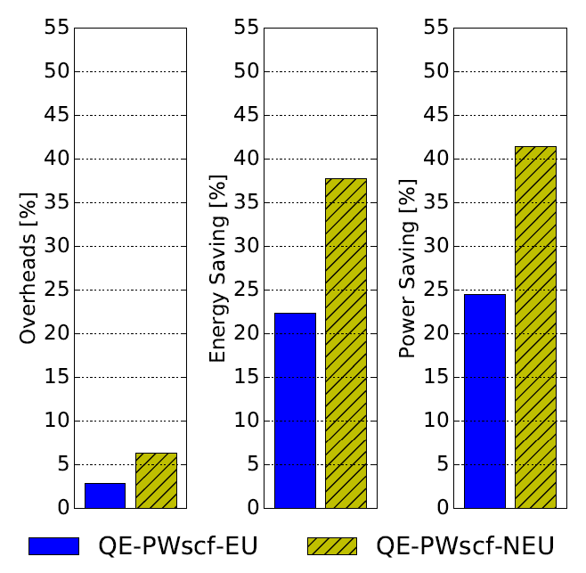
Energy Management
QE pwscf kernel
executed
on 3456 cores
Exper User
Non Exper User
COUNTDOWN (Unibo - http://github.com/EEESlab/countdown) (soon in GEOPM…)
Adjust Proc freq. between MPI calls (longer than 500microsec. – automatically detected),
injecting DVFS capabilities into standard MPI libraries (without code instrumentation – just LD_PRELOAD)
http://arxiv.org/abs/1806.07258

